Slide 1

MSCA 31006
Time Series Forecast
on BAA Corporate
Bond Yield
Bruce Liu, Polly Zheng, Nihaal Zaveri, Jinze Wu
2022 / 05 / 26

Slide 2
Agenda
Problem Statement
Assumptions/Hypothesis
Data Property/Processing
EDA
Feature Engineering
Proposed Approach
Predictive Model
Model Comparison
Future Work Ahead

Slide 3

Problem Statement
Significance of Corporate Bond Yield
Inflation and recession concerns push the US stocks to the brink of a bear market
Volatility persists due to disappointing earnings reports, rising prices, high fuel costs, etc
Offers safer investment, lowers an investor’s risk exposure
Why BAA Rating?
Subject to moderate credit risk and are the threshold between the investment grade bond and the non-investment grade junk bonds.
Higher predictive power for future economic activity than those of higher-grade bonds.
Important for both investors and macroeconomists.

Slide 4



Assumptions/ Hypothesis
Long Term Gov. Yield
3-Month Treasury Rate
Inflation CPI
Term Spread
Total Money Market Fund
S&P Index
S&P Dividend
S&P PE Ratio
Sum of Squared Daily Return
Bond price changes can be explained by multiple macroeconomic variables
Three broad financial asset categories:
Stock Variables
Treasury
Corporate Bonds
Treasury
Stock
Investor will hold bond until maturity
Corp Bond
Default Yield Spread
Default Return Spread
AAA Rating Bond Yield

Slide 5
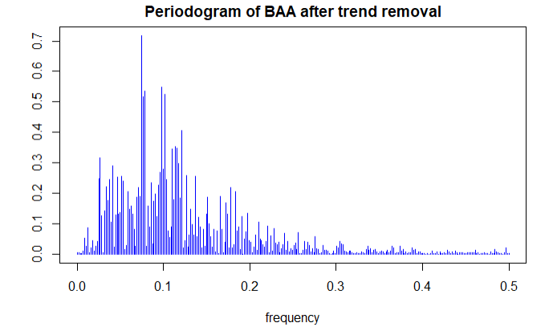
Data Property
Periodogram
BAA Corporate Bond Yield
Obtained from Moody's Seasoned Baa Corporate Bond Yield.
Monthly data ranging from Jan 1974 to Oct 2021
A total of 574 data points.

Slide 6



Data Processing
Reform to Monthly Data
Data Interpolation
Anomaly Detection
Since the BAA corporate bond yield and all the macro variables are disclosed in different statistical scales, we have reformed all data into monthly numbers, ranging from Jan 1974 to Oct 2021.
Total Money Market Fund, one of the macro variables, only has quarterly data available. Monthly number is obtained by going through Linear Spline Interpolation.
Looking for big movement of the BBA corporate bond yield in short periods. This is important to evaluate whether we should incorporate intervention analysis in our models.

Slide 7
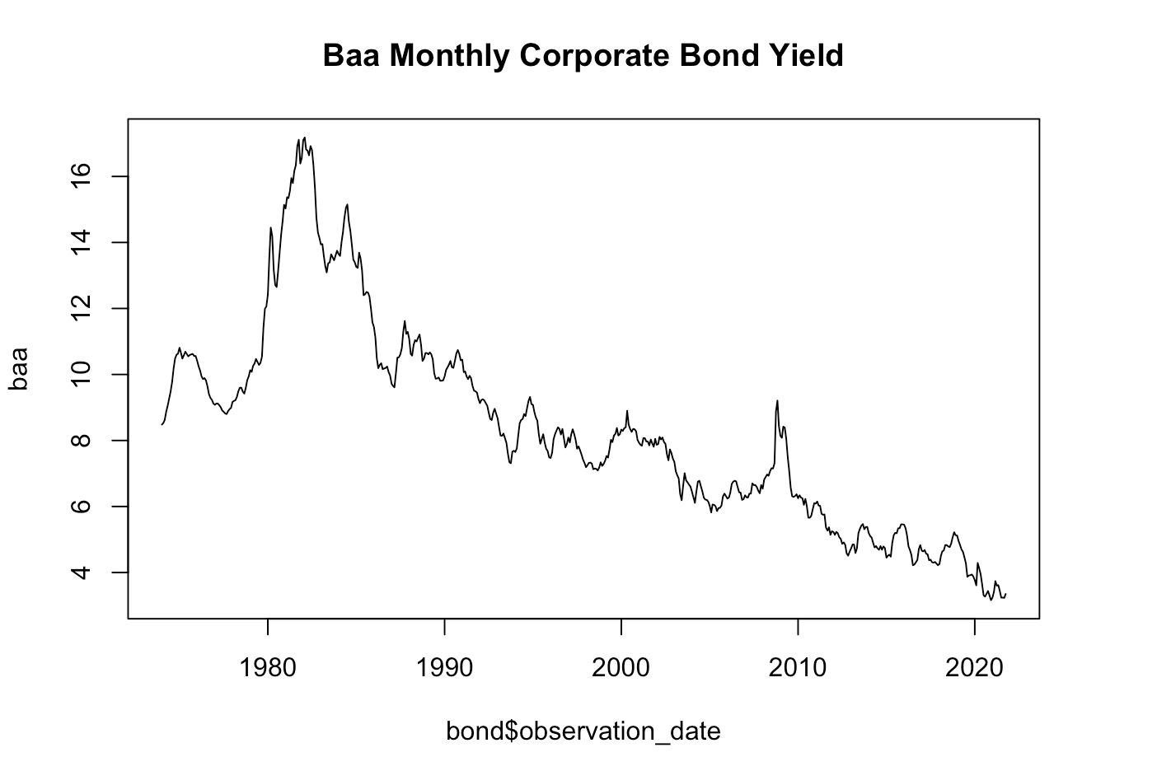
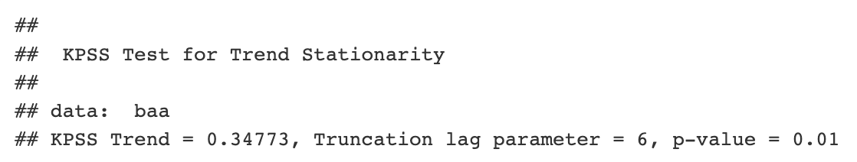
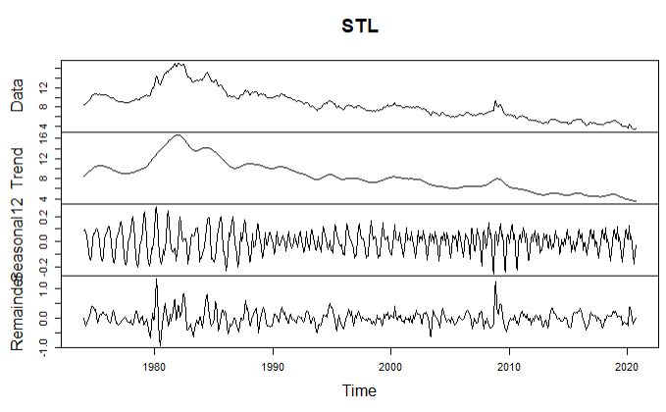
EDA
KPSS Test (Non Stationary)
Intervention Analysis
The early 1980 economic crisis was considered to be the most severe recession since World War II. As unemployment mounted, Federal reserve tightened the money supply for several time, allowing the federal funds rate to reach 20%.

Slide 8
Feature Engineering (Dynamic Regression)
Test stationarity for 11 variables
Only one variable, the monthly sum of squared of S&P daily return in is stationary, all the other variables are non-stationary.
Transform into stationary series
Applied natural log transformation and differencing method
Choose 9 out of 11 variables
Total Money Market Fund and CPI Index remains non-stationary after multiple differencing.

Slide 9
Proposed Approach
Multi-variate
Univariate
Validation
Vector Error Correction Model (Cointegration)
Prophet
Dynamic Regression
Holt-Winter
ARIMA
ARIMA with intervention + GARCH
3-fold Validation
12 step sliding forecast
Compare by average sMAPE
Test set: 2020 Oct. to 2021 Oct.

Slide 10
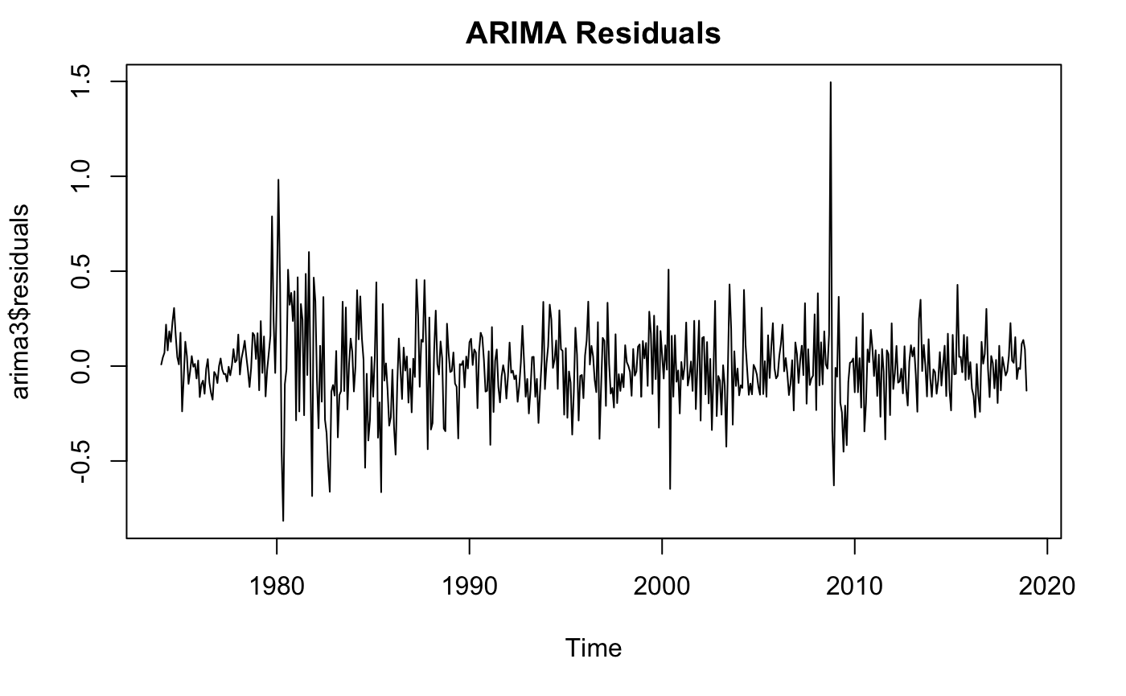
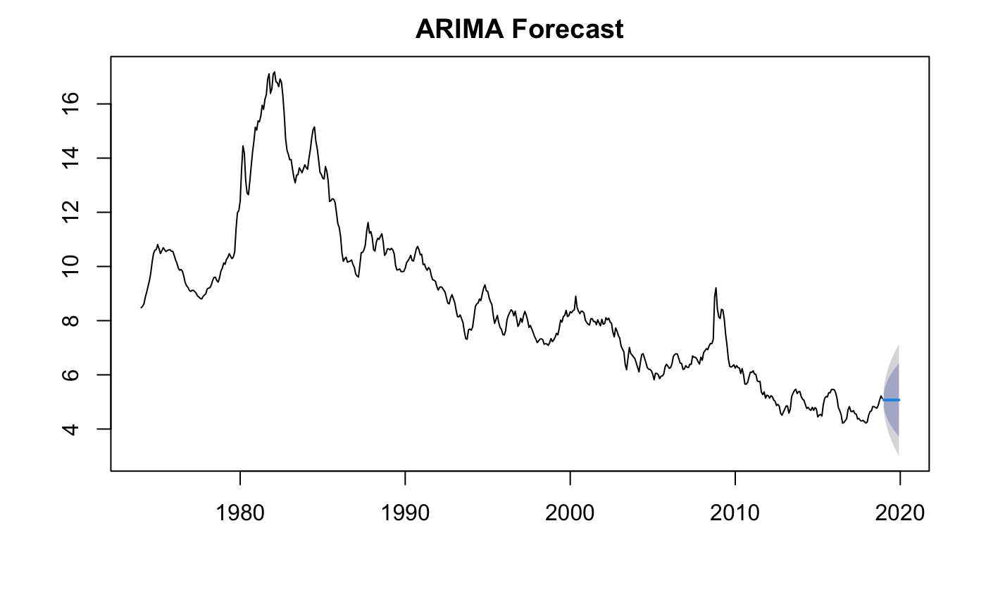
ARIMA
ARIMA (0,1,1)
Residual Analysis: Box-Ljung Test
p-value: 0.6
No autocorrelation of residuals
sMAPE: 0.12

Slide 11
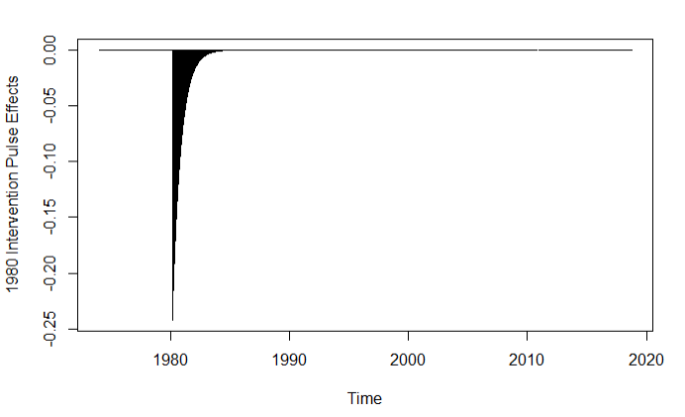
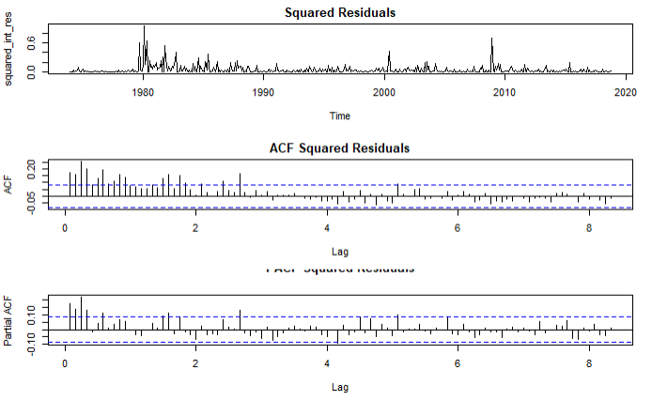
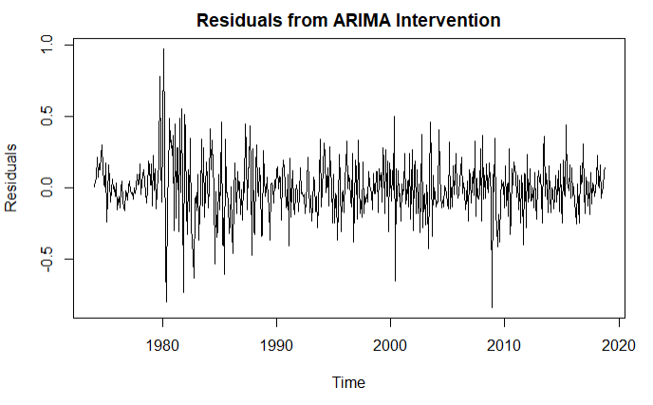
ARIMA with Intervention
Model Result
Pre-Intervention: ARIMA (3,2,0)
March, 1980 Policy Intervention
Residuals show p-value of 0.289 from Ljung-Box test
Resembles white-noise but shows clusters of volatility, suggesting ARCH/GARCH
Low sample size for pre-intervention

Slide 12
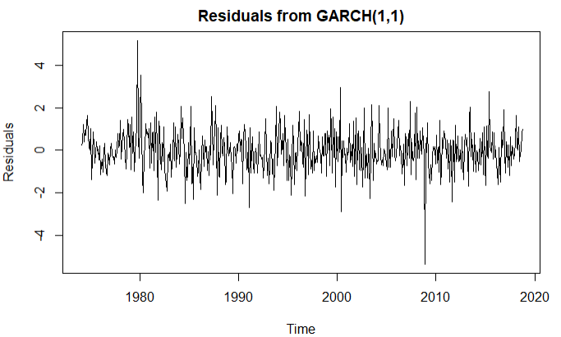
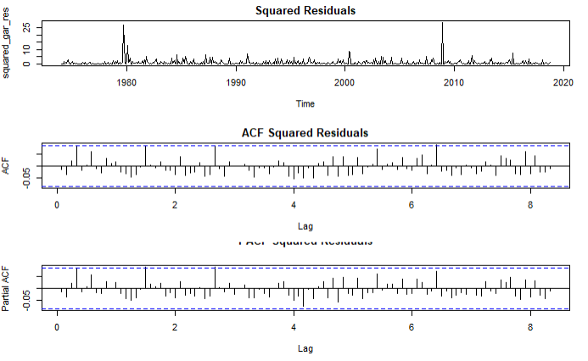
ARIMA with Intervention + GARCH
Model Process
ARCH(0) to ARCH(10) + GARCH(1,1) were tested
GARCH(1,1) is selected for having lowest AIC
Result
ACF/PACF of squared residuals are no longer significant
Ljung-Box test p-value: 0.364
sMAPE: 0.227

Slide 13
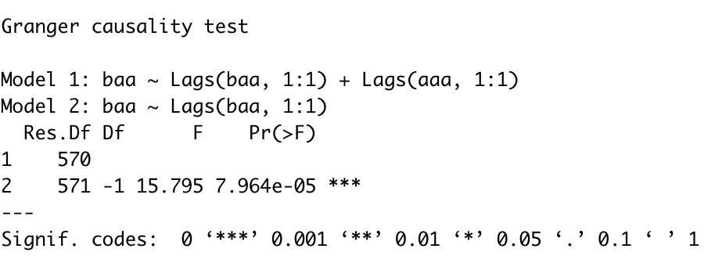
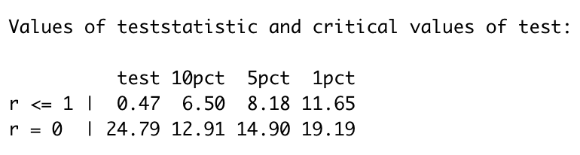
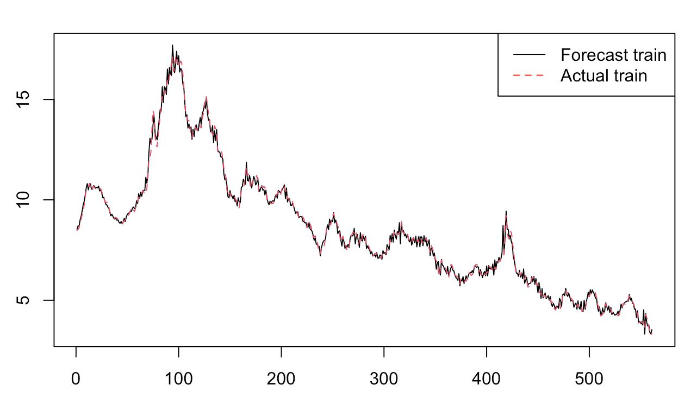
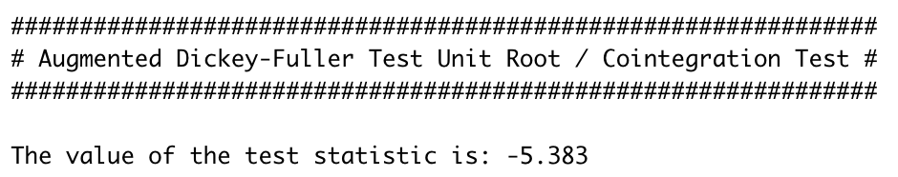
Cointegration: Paired Baa with AAA
Granger Causality Test
Verify Order of Cointegration test
Fit a Vector Error Correction Model
Test for Cointegration
sMAPE: 0.08

Slide 14
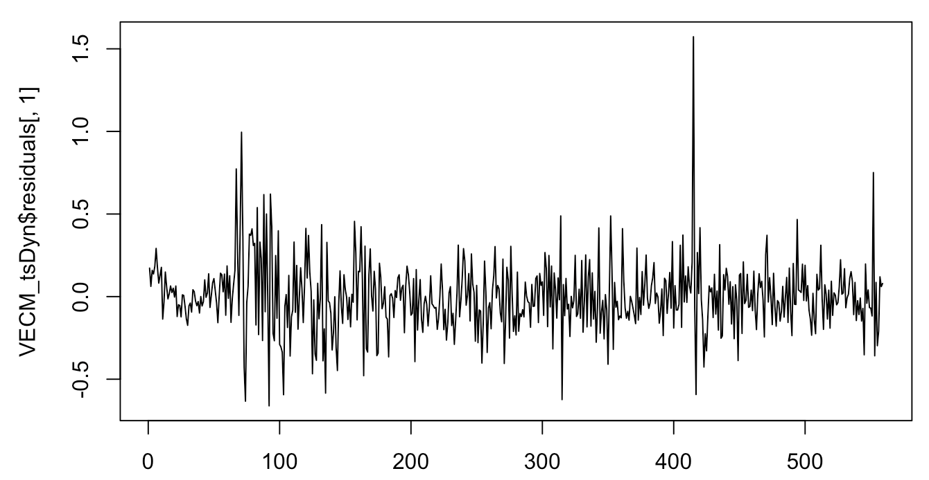
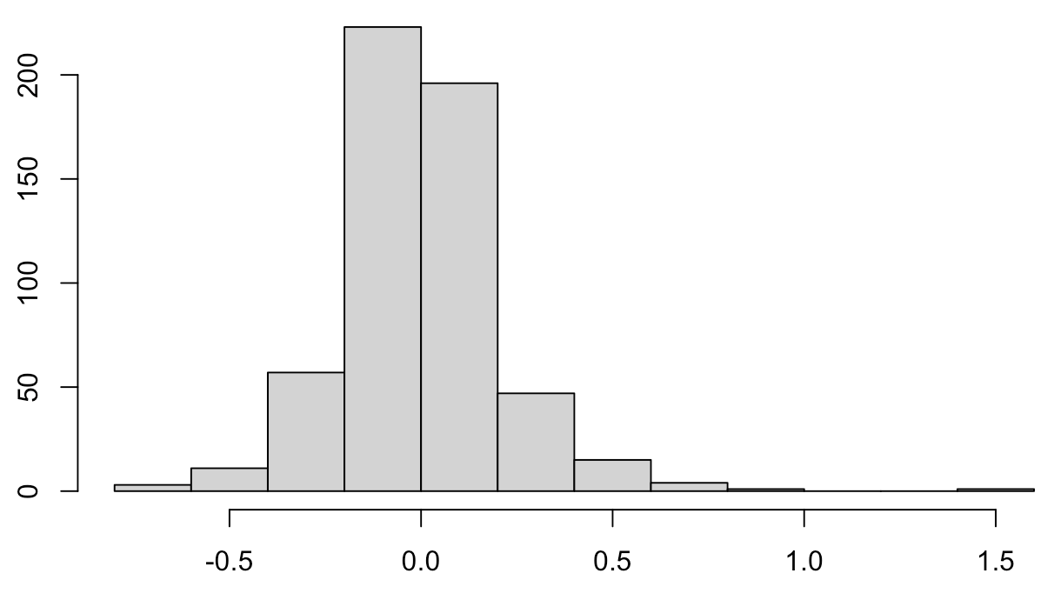
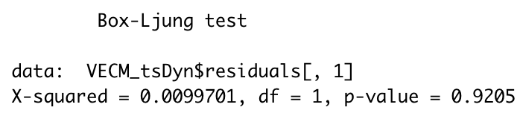
Residual Analysis
Residuals from VECM
Histogram of VECM Residuals
No heteroskedasticity & autocorrelation in residuals

Slide 15
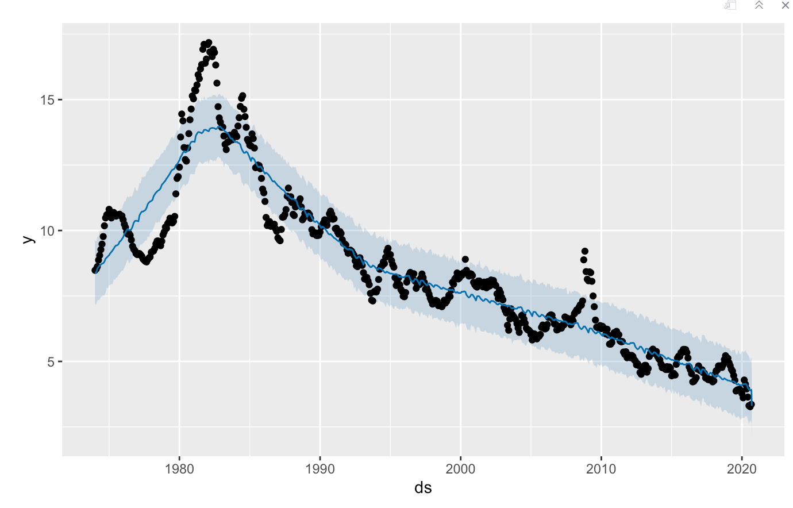
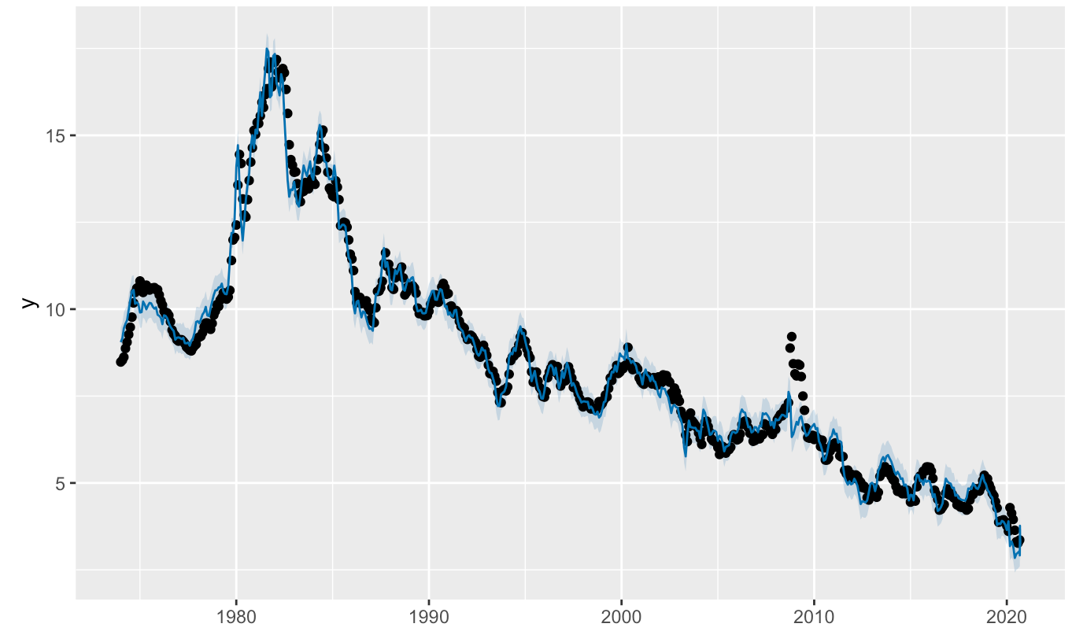
Prophet
Univariate Prophet Prediction
Multivariate Forecast
First tried univariate; doesn’t fit well
Regressed Baa against AAA
Added yearly seasonality
Requires future AAA to be known to predict Baa
Multivariate Prophet Prediction
sMAPE:0.03

Slide 16
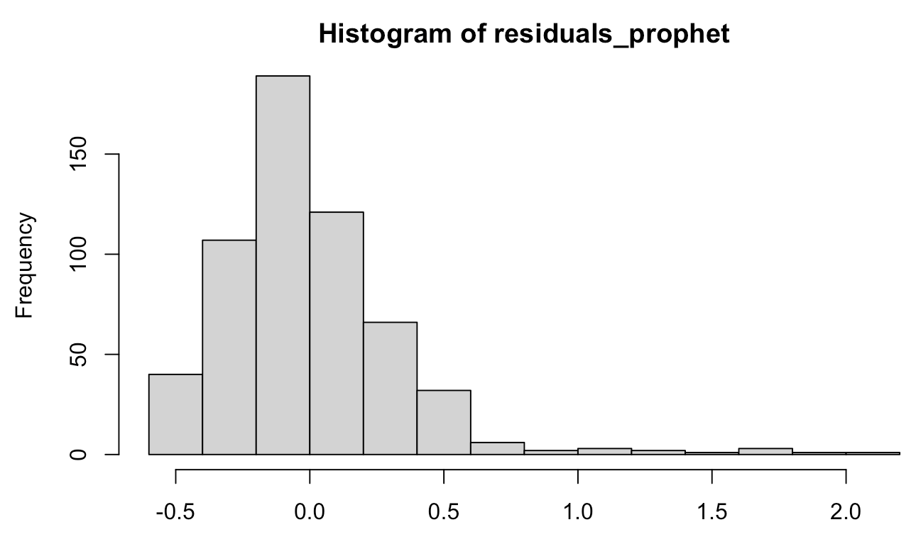
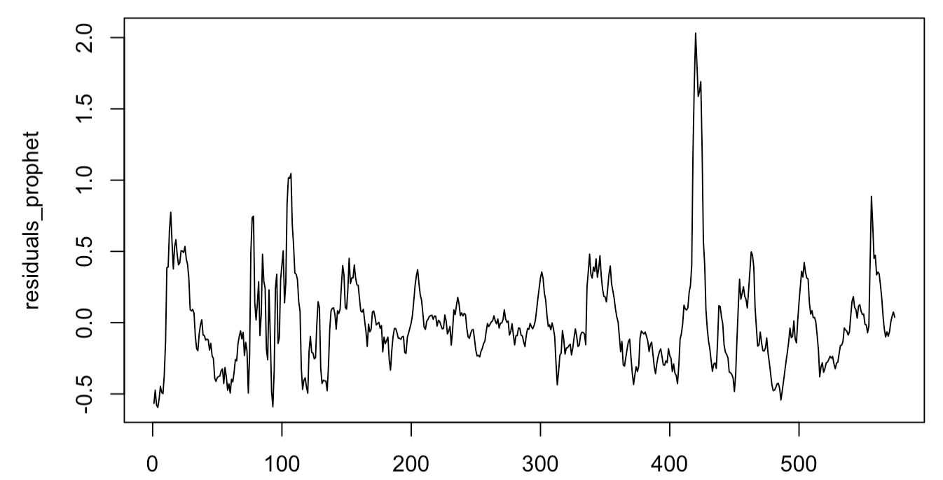
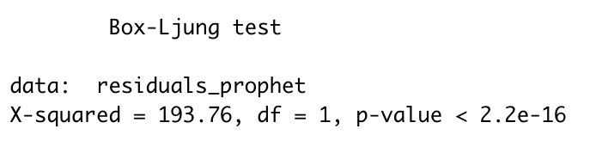
Residual Analysis
Residuals from Prophet

Slide 17
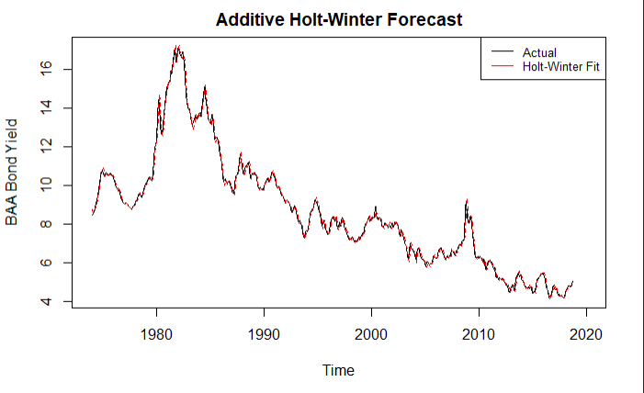
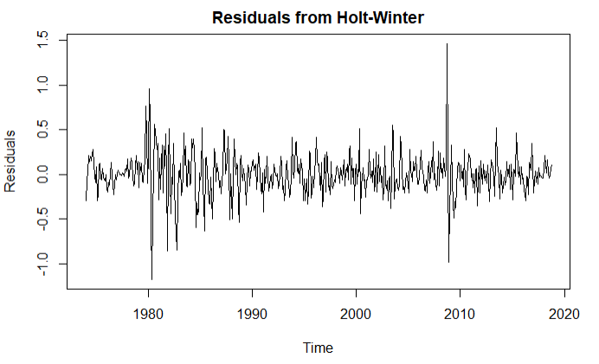
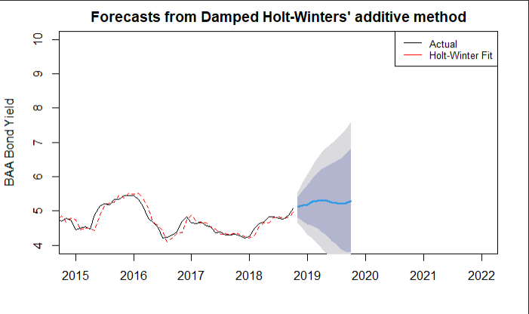
Holt-Winter
Modeling Summary
sMAPE comparison shows additive HW performs better out-of-sample
Ljung-Box test shows p-value of 1.284e-11
Residuals are not stationary
sMAPE = 0.096

Slide 18
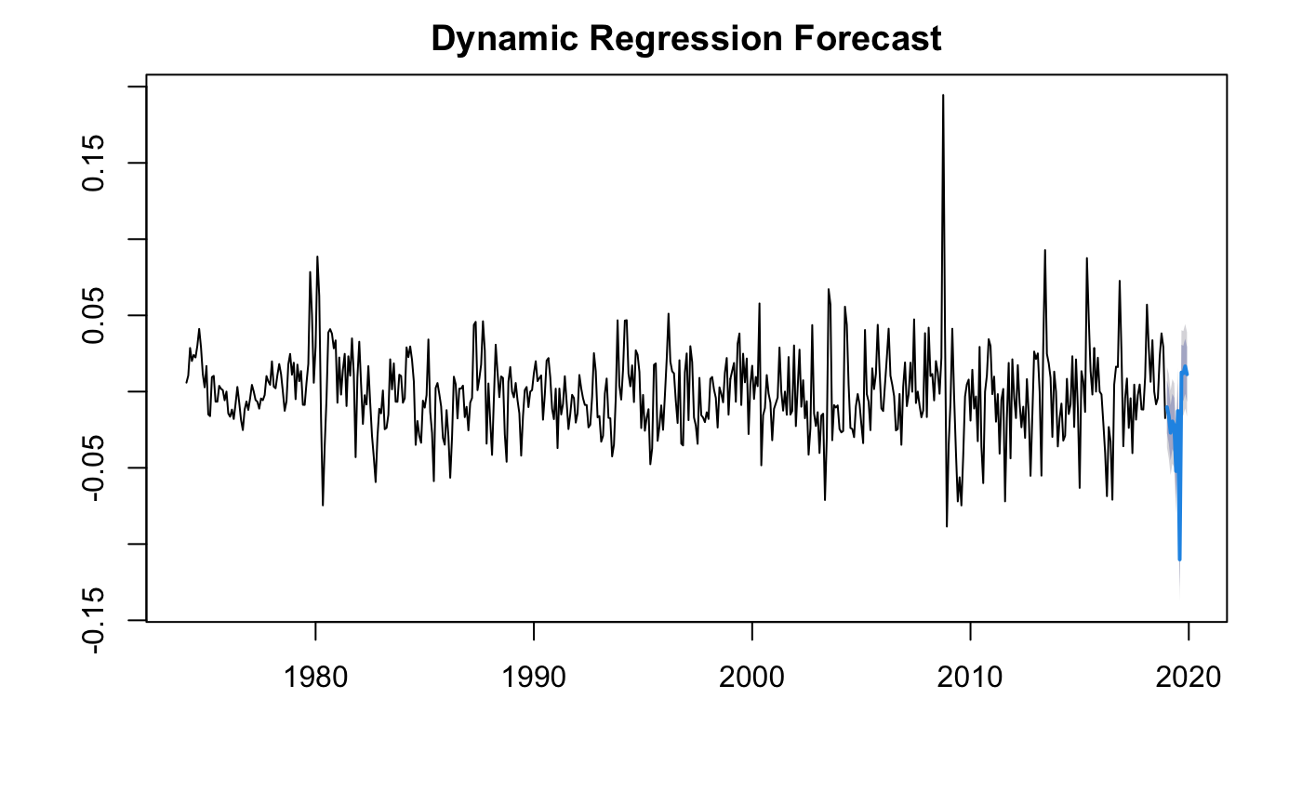
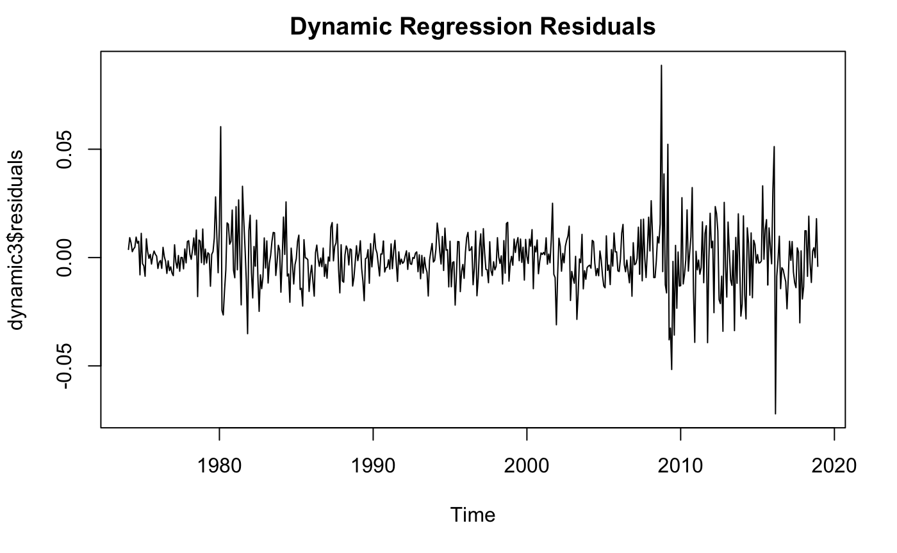
Dynamic
Regression
Residual Analysis: Box-Ljung Test
Χ²: 0.059066
p-value: 0.808
No autocorrelation in residuals
sMAPE value: 0.78
Consumer price index and money market mutual fund were excluded from the predictors. Both variables remained non-stationary after 1, 2, and 3 lag differences.

Slide 19
Model Evaluation
Accuracy Comparison
Residuals Comparison
Model | sMAPE
ARIMA | 0.12
ARIMA GARCH with Intervention | 0.23
Holt Winter | 0.11
Cointegration | 0.08
Dynamic Regression | 0.78
Prophet | 0.03
Model | p value of Ljung-Box test
ARIMA | 0.60
ARIMA GARCH with Intervention | 0.29
Holt Winter | 1.29e-11
Cointegration | 0.92
Dynamic Regression | 0.808
Prophet | 2.20e-16
Final sMAPE for Cointegration on the test set : 0.06

Slide 20



Future Work Ahead
Economical Significance
Machine Learning Model
Discuss the implications and significance of the forecast, how the prediction of the model help traders execute trade and make profit
More Predictors
No machine learning models have been implemented in the project. Try more models including neural networks.
Use all of the 27 predictors from the reference. Conduct proper feature selection process like PCA and lasso before running the regression.

Slide 21
References
GitHub
https://papers.ssrn.com/sol3/papers.cfm?abstract_id=2346299
https://github.com/BruceLiu-dot/MSCA-Time-Series

